Slide 1

Swindon Taxi
Project TDP - 2019
Project by
Sachin Singh

Slide 2
What to expect throughout the presentation
Building
The Steps I took to build my project
Elements
The Elements I used to create and build my project
Why?
Why I chose the elements to my project
Demonstration
A Walk-through of my database & website
What went well & not so well
What would I do differently next time
Q&A?
Finally a funny clip...

Slide 3
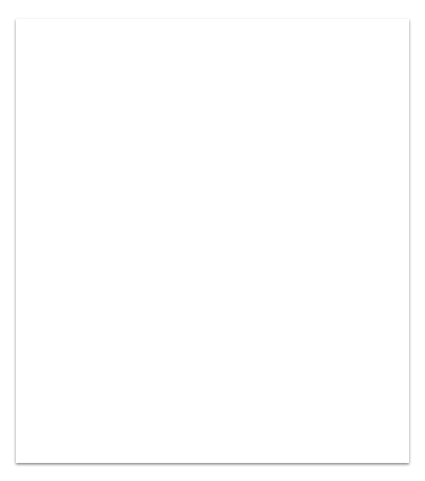
1. Building my project and its elements
Trello Board
Trello is a great collaboration tool that organises project into boards. You can quickly See what’s being worked on, who is working on what and where something is in a process.

Slide 4
1. Building my project and its elements
Trello Board
Trello is a great collaboration tool that organises project into boards. You can quickly See what’s being worked on, who is working on what and where something is in a process.
Wire Frames
This is to show an idea how the project will be looking from start to end of the project where I have used a simple powerpoint presentation to show the frame work

Slide 5
1. Building my project and its elements
Trello Board
Trello is a great collaboration tool that organises project into boards. You can quickly See what’s being worked on, who is working on what and where something is in a process.
Wire Frames
This is to show an idea how the project will be looking from start to end of the project where I have used a simple powerpoint presentation to show the frame work
Design
I used a combination of HTML, CSS, JAVA & JAVASCRIPT to build my project.

Slide 6
1. Building my project and its elements
Trello Board
Trello is a great collaboration tool that organises project into boards. You can quickly See what’s being worked on, who is working on what and where something is in a process.
Wire Frames
This is to show an idea how the project will be looking from start to end of the project where I have used a simple powerpoint presentation to show the frame work
Design
I used a combination of HTML, CSS, JAVA & JAVASCRIPT to build my project.
MySql Database
SQL is the most popular language for adding, accessing and managing content in a database. It is most noted for
it’s quick processing, proven reliability, ease and flexibility of use..

Slide 7
1. Building my project and its elements
Trello Board
Trello is a great collaboration tool that organises project into boards. You can quickly See what’s being worked on, who is working on what and where something is in a process.
Wire Frames
This is to show an idea how the project will be looking from start to end of the project where I have used a simple powerpoint presentation to show the frame work
Design
I used a combination of HTML, CSS, JAVA & JAVASCRIPT to build my project.
Spring Boot
Spring Boot is a project built on the top of the Spring framework. It provides a simpler and faster way to set up, configure and run both simple and web-based application.
MySql Database
SQL is the most popular language for adding, accessing and managing content in a database. It is most noted for
it’s quick processing, proven reliability, ease and flexibility of use..

Slide 8
The Journey
Planning
User stories on Trello board and initial ideas
Action
Deciding on the elements to construct the website & database.
Implementation
Building an API and integrating the data onto the website and formatting.
Start
End
Designing
Gathering information &
Creating wireframes
Developing
Constructing website and building database and testing.
Final Product
Test the final product.

Slide 9

Choosing my elements & why.
Website Design
Although there are stylesheets that can be linked from the internet i.e. BootStrap, I decided to build my HTML and CSS from the ground up as to not be restricted to a certain style.
Although BootStrap looks good, I chose “Function over Form” to enable the website to work first and look good after.

Slide 10
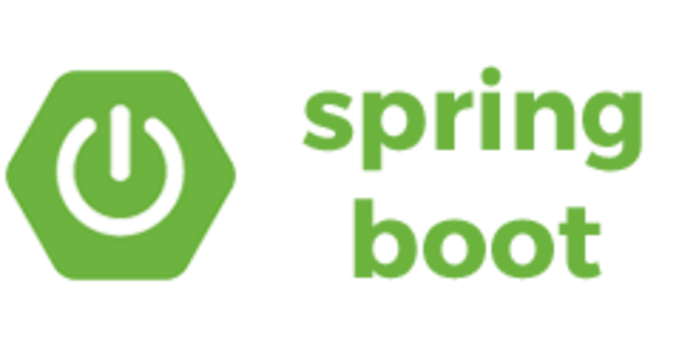
Choosing my elements & why.
Spring Boot
I chose to use Spring Boot as it’s very easy to develop Spring Based applications with Java. I used the Spring Framework inside a Maven Project using Eclipse to aid in writing my code to run and link to my database.
Using Spring Boot and the Spring Framework reduces lots of development time and increases productivity to allow me to build my project in the time provided.

Slide 11

Choosing my elements & why.
MySql Database
MySql is the most popular language for adding, accessing and managing content in a database. It is most noted for its quick processing, proven reliability, ease and flexibility of use.

Slide 12

What went well...
Not so well...
I was able to create a project that
successfully pulled credentials from database and gave access to the user.
I was able to add user addresses
successfully to database for future use.
Although I was unable to fully integrate all the features I had planned, I did finish with a working website that could give all information to the user..
I wasn’t able to make the website look good as we had a very little training on applications to build website..
Although I had a working website, some of my initial functions were left out due to the difficulty level and time (displaying google maps and different fares for different route options...

Slide 13
Website and database demonstration
www.SwindonTaxi.co.uk

Slide 14
My friends...
Questions Please….
www.SwindonTaxi.co.uk

Slide 15
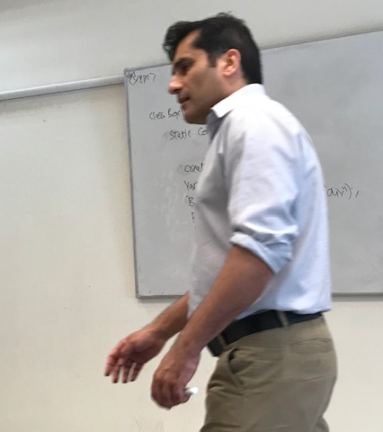
Thanks for training us
Mr. The Shafeeq
Tadas
John
My Friends
Screens Please
Shafeeq is back
I hate everyone in this whole world.
Take a deep breath calm down.

